Slide 1
Car Price Forecasting
Predicting Resale value of Cars using Machine Learning
Submitted by - Achyuta Samantaray
Gmail - ctc.achyuta@gmail.com
Git Hub - https://github.com/achyutasamantray

Slide 2
Problem Statement • Selling used cars often lacks accurate pricing • Manual price estimates are often subjective and inconsistent • Human-based estimates lack accuracy • A smart data-driven model ensures consistent predictions

Slide 3
Objectives • Predict the selling price of a car based on features • Provide an easy-to-use web interface for users • Allow both manual input and dataset upload • Enhance customer trust and transparency

Slide 4
Tools & Technologies
Python Libraries: Pandas, NumPy, Seaborn, Matplotlib, Datetime, Scikit-learn, XGBoost
Frontend: Streamlit (interactive UI)
Model: Linear Regression, Random Forest Regressor, XGBoost Regressor
Hosting: Streamlit Cloud - Interactive UI, responsive on both Windows & Mobile devices (via GitHub)

Slide 5
System Architecture 1. User Inputs (manual/dataset) 2. Data Preprocessing - cleaning data, encoding categorical variables into numbers and calculating car age from purchase year. 3. XGBoost Model 4. Predicted Selling Price 5. Output shown in Web App

Slide 6
Features of the App • Manual entry for single car details • CSV/Excel upload option • Live price prediction • Interactive UI with balloons • Dynamic calculation of car age

Slide 7
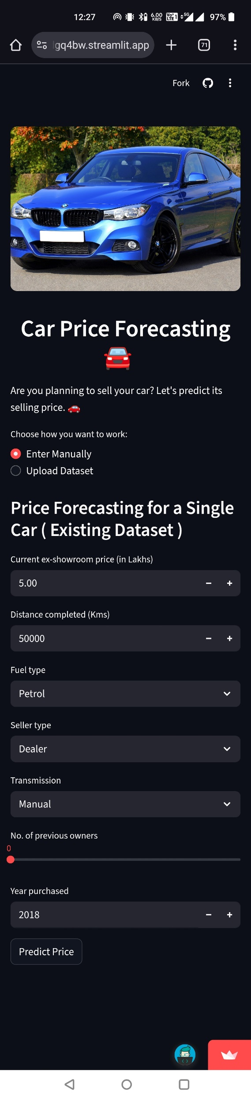
Demo Home screen

Slide 8
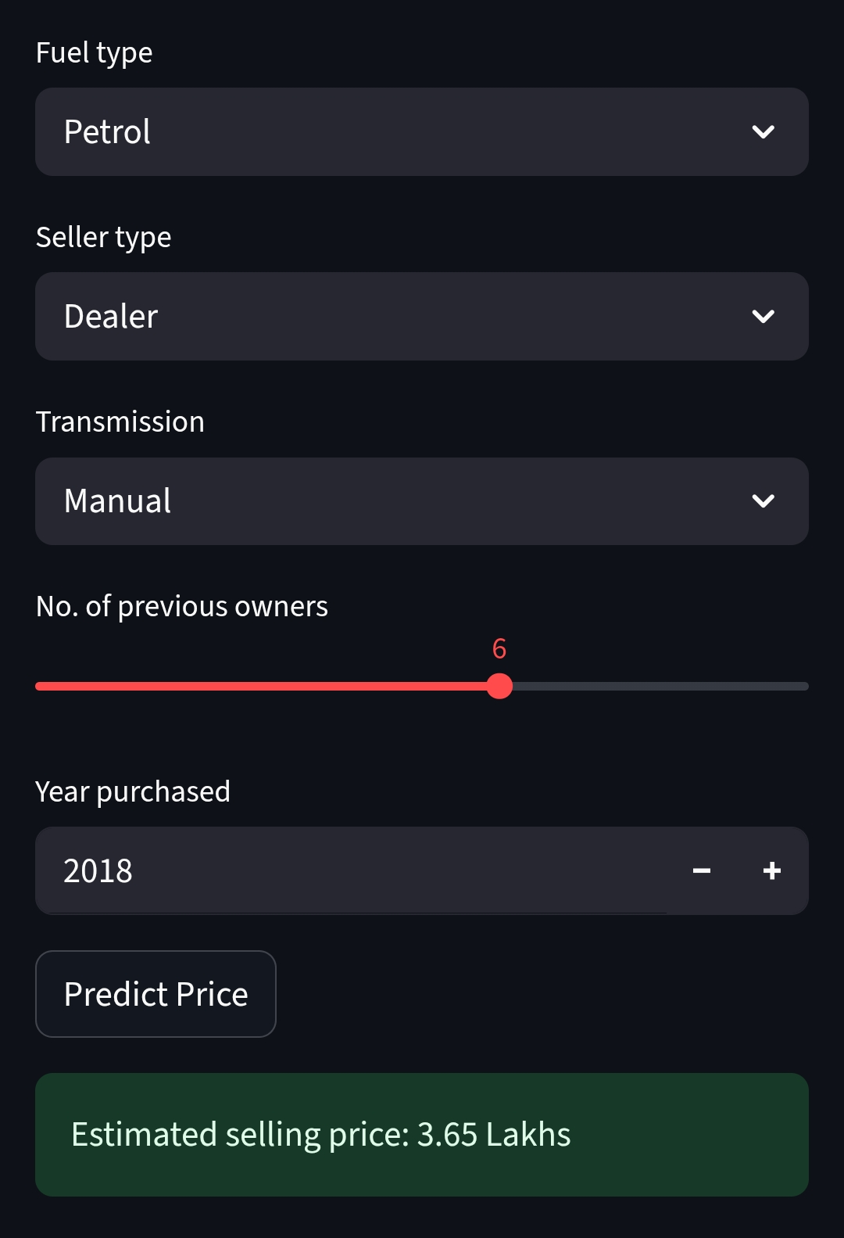
Manual Input Form

Slide 9
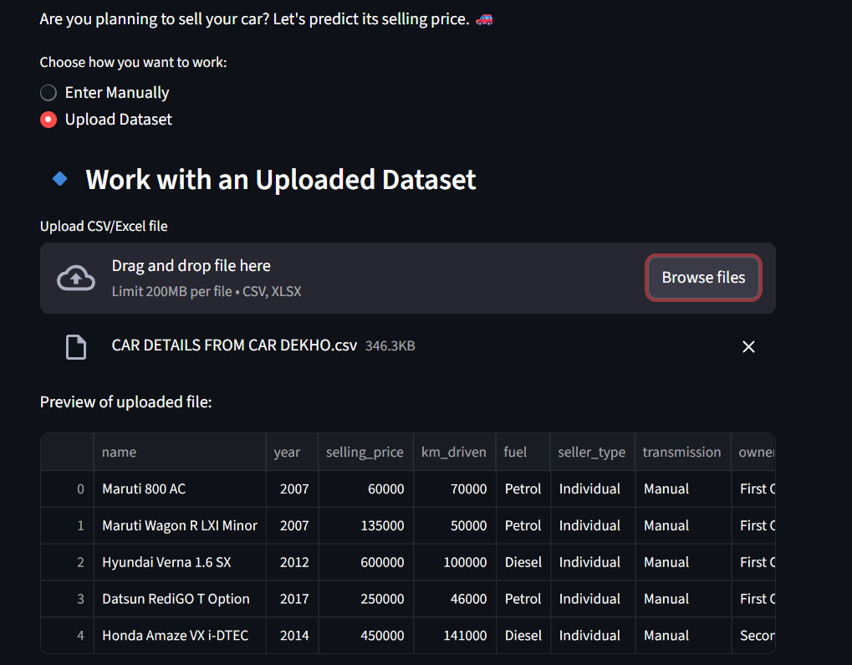
Upload Dataset Option

Slide 10
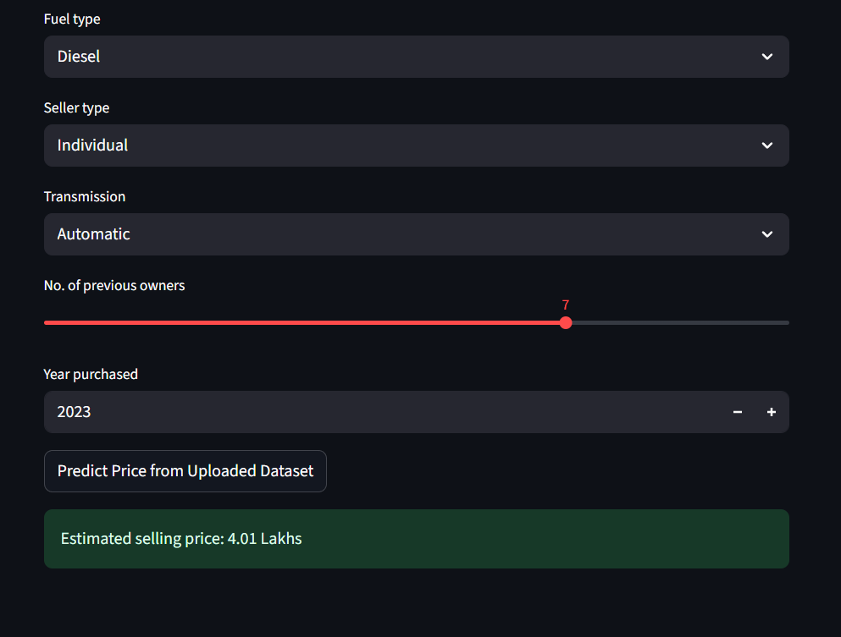
Prediction Output

Slide 11
Advantages • Easy to use, even for non-technical users • Fast predictions in seconds • Cloud-hosted, accessible anywhere • Works seamlessly on Windows & Mobile devices • Secure and scalable for large datasets

Slide 12
Conclusion 1. Combines ML (Linear Regression, Random Forest, XGBoost Regressor) + Web App (Streamlit) 2. Among all models, XGBoost Regressor achieved the highest accuracy (best R² score). 3. Final model deployed using XGBoost for better performance. 4. Provides a scalable and user-friendly solution hosted on Streamlit Cloud. 5. Output shown in Web App.

Slide 13
Thank You 🚘

